Slide 1
security control system
A system that helps you to make your home safe

Slide 2
Created by
Ahmed elsayed farouk
Ebram Rasmy
Abanoub merzik shenouda khilla
Ebtisam Sayed Mahfouz
Ahmed Abd Elzaher Ahmed
Ahlam Reda Abd Elmonim

Slide 3
the introduction
In recent years, thieves have developed their various methods of theft, which made securing homes a difficult task, especially since we still use the same old and traditional methods to protect our homes and families, despite the presence of many advanced protection devices.
Therefore, in this project, we are developing an electronic system that makes it easier for the customer to use various security devices such as (door stoppers, motion sensors, smart door locks, HD video cameras, water and gas leakage sensors) where it is easy to use these devices via a mobile phone

Slide 4
Project Charter
Project name: security control
Project sponsor: Ministry of Communications and Information Technology
Project manager: Eng/ Walid Mohamad Ali
Purpose of the project: Building protection

Slide 5
Business casel:
the home security system project consists of three basic modules.
The first one is the IR transmitter and receiver module which works for the safety of doors at night or in case we are out of the home.
When the IR sensors are interrupted, a buzzer if turned on indicating someone is entered into house. The second module is LPG gas sensor.
It is provided to detect LPG gas leakage. A buzzer is turned on when Gas is detected by the sensor.
The third part of the project serves the functionality of a door-latch opening using a password entered through the keypad.
This module also turns on buzzer if 3wrong passwords are entered consequently. Data from all modules is sent to a computer through the serial port.
Applications and Advantages:
1. Can be used in house for security purpose.
2. Same project can be implemented in industry or educational institutes.
Future Development for the project:
1. We can send this data to a remote location using mobile or internet.
2. We can implement other related modules like fire sensor, wind sensor.
3. We can add the module of voice alarm system to indicate theft entry or gas leakage.

Slide 6
Project scope
It is an application through which you can control the camera systems in your home or company and also control the protection systems such as the laser system in companies
1- The application will show the user the status of all devices (On or Off)
2- The application will show the user the footage from the camera.
3- The application allows the user to control the door locks remotely.
4 - The application allows the user to keep a copy of what the surveillance cameras film and watch.
5 - It provide the user with a report (daily, weakly, or monthly) of the Consumption of each device to help him to reduce the total consumption.
6- It sends a notifications to the user if there are a device still turned on for along time (like chargers), and the user can allow access to turn it off automatically.
7- The application sends an alert to the user when the sensors and monitoring devices are compromised

Slide 7
Key deliverables of the project:
It is an application designed to make it easier for the customer to control the various security devices in the house such as (door stoppers, motion sensors, smart door locks...etc.) and it can also know the electricity consumption of each device

Slide 8
Project milestones (Timeline of project):
1- In the first two weeks, the team of electrical engineers will collect information on remote control and consumption of electrical devices.
2- For month, engineers will make remote receivers.
3- For Two weeks, a team of programmers will make the mobile application.
4-The project is being tested for a week

Slide 9
Project resources:
1- A team of electrical engineering.
2- A team of programming.
3- Device of receiver
Budget: 300,000$.
Staff:
- A team of electrical engineers.
- A team of programmers.
Vendor:
Marketing companies, and internet markets (like Amazon, and Google play)

Slide 10
Budget:
300,000 $ (includes servers, project licenses, developers, designers, training)

Slide 11
Constraints:
1-The project must take time less than three months.
2-The project must not exceed 300,000 $.
3-laptops and computers must be bought from dell company.

Slide 12
Assumptions:
1-The project does not take more than three months.
2-The cost no more 300,000$ .
3-Efficiency in the devices.

Slide 13
High level risks:
1-Damage in the receivers.
2-Increase in the cost.
3-The lack of efficiency sufficient in the receiver or the teams.
4-Not to satisfy the users of product.

Slide 14
Project scope

Slide 15
1 - Project Scope Distribution:
It is an application through which you can control the camera systems in your home or company and also control the protection systems such as the laser system in companies and also through which you can follow the cameras moment by moment through your mobile phone,
It also allows you to control electrical appliances such as lamps, and control electronic doors.

Slide 16
2- Project acceptance criteries:
Functionality, performance, development ,method, Easy to use and faster

Slide 17
3- Project deliverables:
- An application allow you to control all the security devices and control electrical devices inside the house
- Project plan, reports, documents and resources which return to the company

Slide 18
4- Project exclusion
One of the clients demand adding His company within the project but the sponsor and manager refuse this reques as it need much time and the project will not end on time and also will cost much money.

Slide 19
5- project constraints
- The project must take time less than three months.
- The project must not exceed 300,000$.
laptops and computers must be bought from dell company or App company. -
- Equipment must be highly efficient.
- Each device must be used in its designated place to perform its role efficiently

Slide 20
6-Project Assumptions:
The application can run on all operating systems such as IOS and Android OS

Slide 21
security control
WBS
1.1
Starting
1.2
Hardware and
Software
1.3
Coding
1.4
Finishing
1.1.1
Requirments 1.1.2
Policies 1.1.3
Doing Study about the Project
1.1.4
Plan the Project
1.2.1
Procurements
1.2.2
Operating System
1.2.3
Testing Devices
1.2.4
Alarms and surveillance cameras
1.3.1
Dividing Tasks 1.3.2
Coding the Functions in all Tasks
1.3.3
Test Functions 1.3.4
Interface the Application
1.4.1
Test the Application
1.4.2
Explain and Fixed Errors
1.4.3
Finish the Application
1.4.4
Install the Application

Slide 22

Dictionary wbs

Slide 23
1.1 Starting
1.1.1 | Work PackageID
Requirment | Work Package Name
Meeting with team,Stakeholder and Sponser | Description
Manager & Team Members | Person
1 Decemper 2021 | Start Date
4 Decemper 2021 | End Date

Slide 24
1.1.2 | Work PackageID
Policites | Work Package Name
Know the Policites and Recommends of the minister | Description
Manager | Person
Decemper 20215 | Start Date
Decemper 202111 | End Date

Slide 25
1.1.3 | Work PackageID
Doing Study about the Project | Work Package Name
Collecting all information about the project | Description
Manager and Team Member | Person
12 decemper 2021 | Start Date
22 decemper 2021 | End Date

Slide 26
1.2 Hardware and Software
1.2.1 | Work PackageID
Procurements | Work Package Name
Purchase all the necessary devices for the project such as computers, cameras and Alarms | Description
Project sponsor | Person
22 decemper 2021 | Start Date
25 decemper 2021 | End Date

Slide 27
1.2.2 | Work PackageID
Operating System | Work Package Name
All operating systems | Description
Programming team | Person
25 Decemper 2022 | Start Date
3 January 2022 | End Date

Slide 28
1.2.3 | Work PackageID
Testing Devices | Work Package Name
Test all devices and verify their ability to work on the application | Description
Team of electrification engineers | Person
January 20223 | Start Date
January 20226 | End Date

Slide 29
1.2.4 | Work PackageID
Alarms and surveillance cameras | Work Package Name
Equipping the equipment of the alarms, protection and boats in all aspects | Description
Team of electrification engineers | Person
6 January2022 | Start Date
9 January 2022 | End Date

Slide 30
1.3 Coding
Work.Package.ID | 1.3.1
Work Package Name | Dividing Tasks
Description | Electrical engineers make the parts that will be placed in the devices to be controlled Programming engineers program these devices
Person | Software engineers and electrical engineers
Start Date | 9 January 2022
End Date | 16 January2022

Slide 31
Work Package.ID | 1.3.2
Work Package Name | Coding the Functions in all Tasks
Description | make coding for all functions of the program
Person | Software engineers
Start Date | 16 January 2022
End Date | 19 January2022

Slide 32
Work Package.ID | 1.3.3
Work Package Name | Test Functions
Description | Test all functions of the program and verify their ability to work on the application
Person | Team of programing engineers
Start Date | 19 January 2022
End Date | 22 January 2022

Slide 33
1.3.4 | Work Package.ID
Interface the Application | Work Package Name
An application programming interface is a description of programming elements according to their functions, inputs and outputs. Its main objective is to provide a list of functions that are completely independent of the mechanism in which they are implemented, to allow others to communicate with them through any mechanism | Description
Team of programing engineers | Person
22 January 2022 | Start Date
26 January 2022 | End Date

Slide 34
1.4.1 | Work Package.ID
Test the Application | Work Package Name
Testing the program is working or not working | Description
Manager & Team Members | Person
January 2022 27 | Start Date
January 202230 | End Date
finishing

Slide 35
1.4.2 | Work Package.ID
Explan and Fixed Errors | Work Package Name
Run to program ,if there are errors must be quickly resolved by software engineering team | Description
Software engineering team | Person
February20221 | Start Date
February20226 | End Date

Slide 36
1.4.3 | Work Package.ID
Finish the Application | Work Package Name
After correcting the errors, it is completed immediately | Description
Manager & Team Members | Person
February20227 | Start Date
February202217 | End Date

Slide 37
1.4.4 | Work Package.ID
Install the Application | Work Package Name
Immediately after finishing the Application, installation is done step by step to complete the installation. | Description
Users &Team Members | Person
February202218 | Start Date
February202228 | End Date

Slide 38
Preceding Activity | Description | Activity
None | Define Requirement | A
A | Assign team | B
A | Design Hardware | C
B | Code Software | D
C | Build& test Hardware | E
C | Develop Patent Request | F
D | Test Software | G
E,F,G | Integrate Systems | H

Slide 39
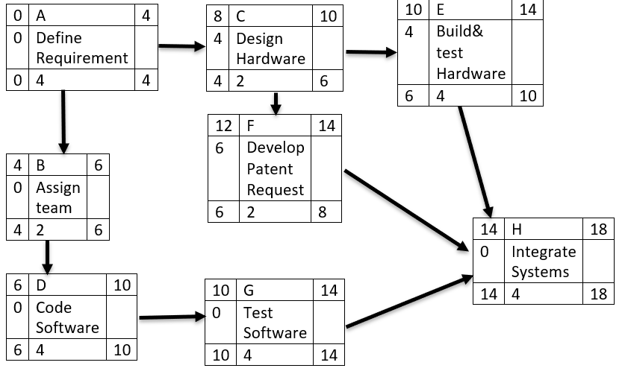

Slide 40

Resource-Constrained schedule

Slide 42
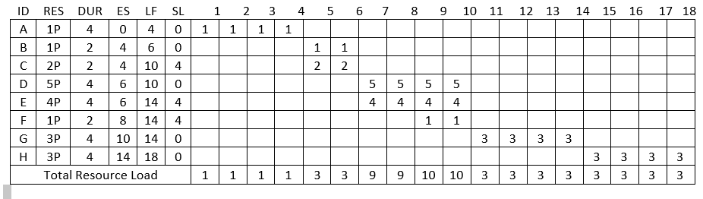

Slide 43
Baseline Budget

Slide 44
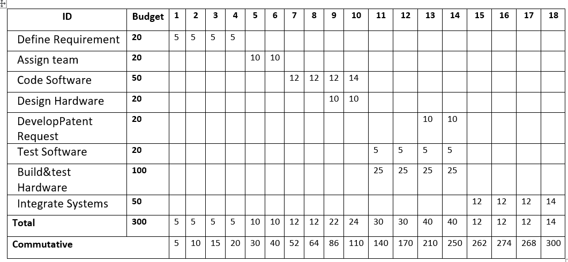

Slide 45
Risks

Slide 46
Negative risks:-
1-Interruption of the Internet.
2-hackers.
3-One of our employees leave the company.
4 -Another competitive company make the same technology with better quality than us.
5 -Damage in the receivers.
6 -Increase in the cost.
7 -The lack of efficiency sufficient in the receiver or the teams. -Not to satisfy the users of product

Slide 47
Positive risk:-
-There is only our company in the market.
-Make a change in company that may improve our technology.
-This application work The IOS and Android and windows operating system

